Slide 1
Sheet Metal Forming Processes

Slide 2
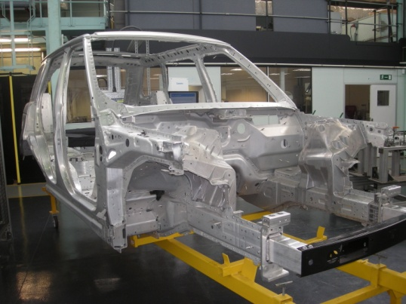
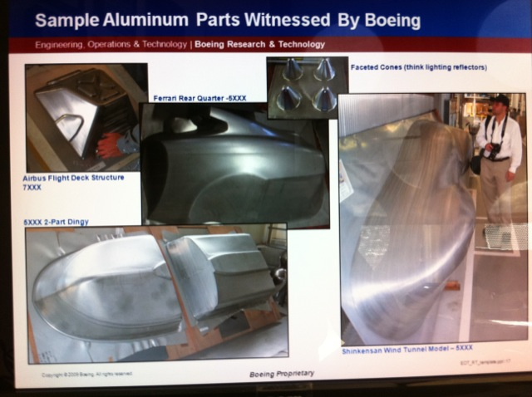
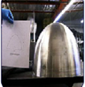

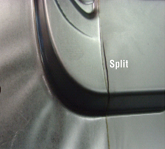
Why Formability?
The ease with which a sheet can be formed into a specific shape without fracture/excessive thinning.
Formability is controlled by the material properties: Strain hardening exponent (n), Anisotropy coefficient (R) and Strain rate sensitivity index (m)
autobody
Aircraft structures
Splitting
Localized necking
Home appliances
Personal communication with Prof. R. Dashwood, Univ. of Warwick and Prof. J.W. Yoon of Deakin Univ., and Banabic et. al., 2000, Formability of Metallic Materials
2

Slide 3
Common sheet metal operations
stretching
deep drawing
bending
blanking and piercing
coining
Ironing
A complex stamping is formed by combination of the above processes.

Slide 4
A schematic showing common sheet metal forming operations

Slide 5
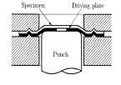
Stretching
In-plane stretching
Out-of-plane stretching
Formability measure
Limiting dome height
Forming limit strain
Strain distribution
In-plane stretching
Out-of-plane stretching

Slide 6
Punch-die assembly for punch stretching experiments

Slide 7
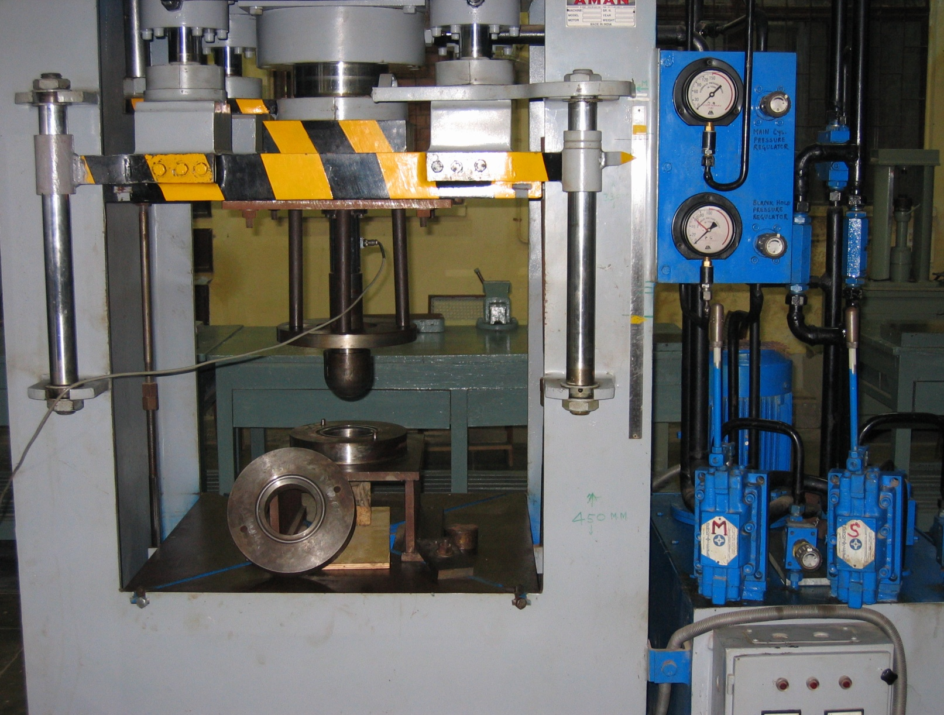
Blank holder pressure gauge
Lower die
Blank holder
Lever for blank holder movement
Load cell
Lever for Punch movement
Upper die
hemispherical Punch
Limiting dome height test of parent metal with blank holding force of 12-15 tonnes with data acquisition system for load-displacement graph in 100 ton hydraulic press.

Slide 8
Stretch formed specimens

Slide 10
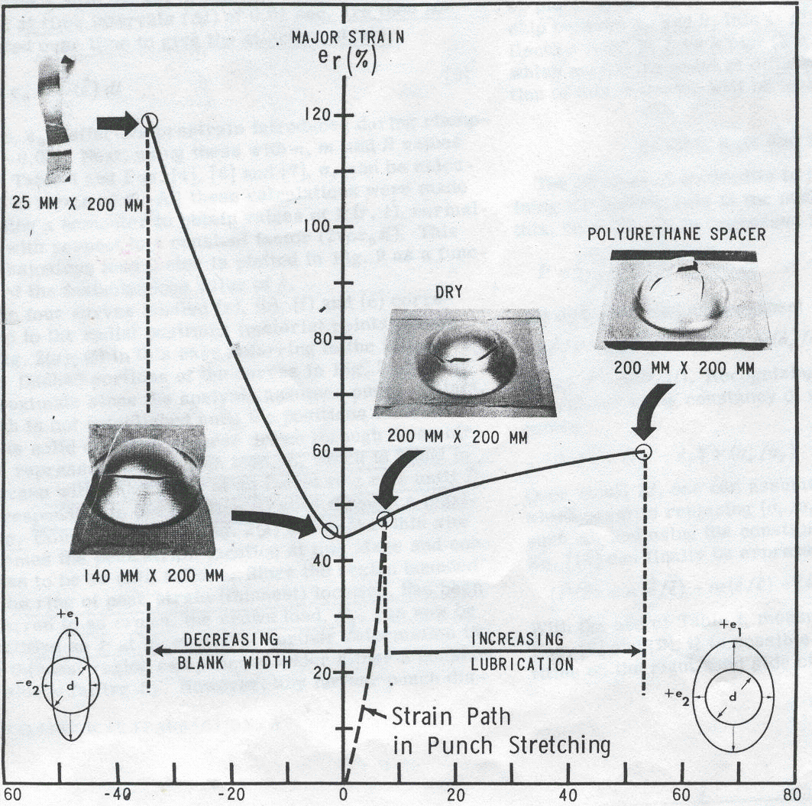
Forming limit diagram
Or
Forming limit curve

Slide 11
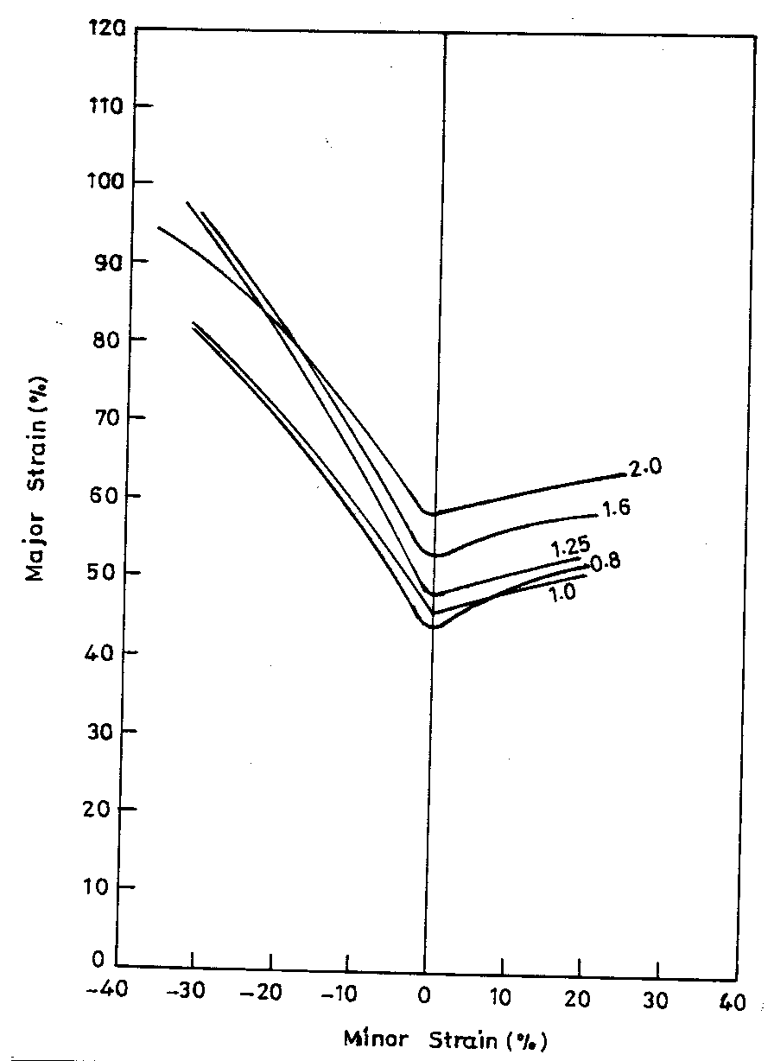
A comparison of the forming limit diagrams of five heats of the EDD steel

Slide 13
condition | LDH(mm) for DQ steel sheet
dry | 32
Lubricated (with PU) | 41.32
Uniform deformation in the blank due to lubrication

Slide 14
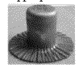
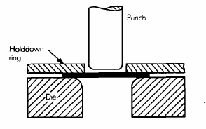
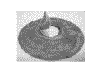
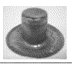
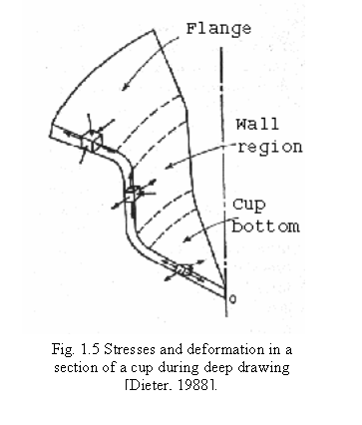
Deep Drawing
wrinkling
Fracture at die corner
Fracture at punch corner
earing

Slide 15
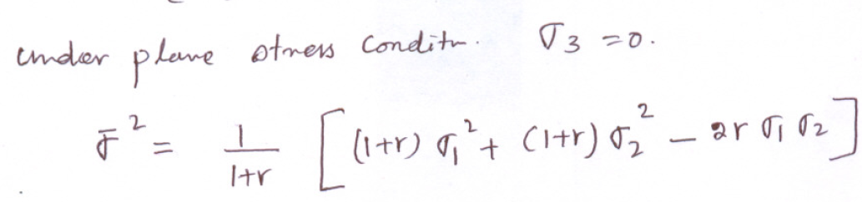
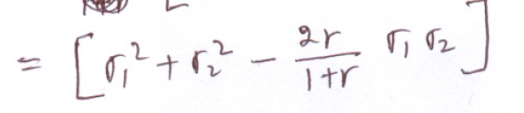
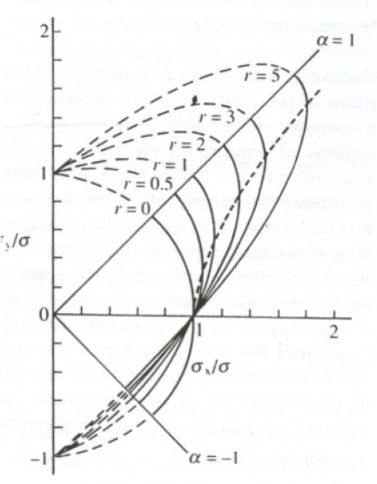
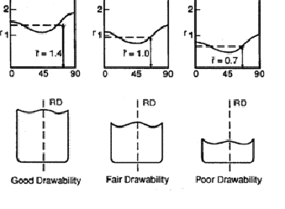

Slide 16
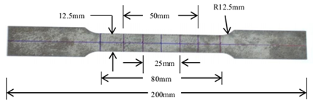
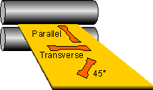
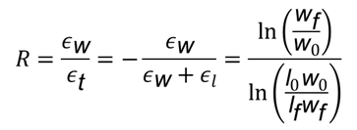
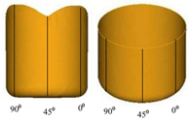
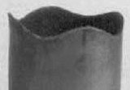
Anisotropy measurement and Earring prediction
1
Normal Anisotropy
Planar Anisotropy
Lankford Anisotropy Coefficient
RD
For isotropy,
Material | R₀ | R₄₅ | R₉₀ |  | ΔR
IF Steel | 2.12 | 1.73 | 2.47 | 2.01 | 0.565
Hill’s(1948) Yield Function for Plane Stress
Experiment | Hill’s | von-Mises
6

Slide 17
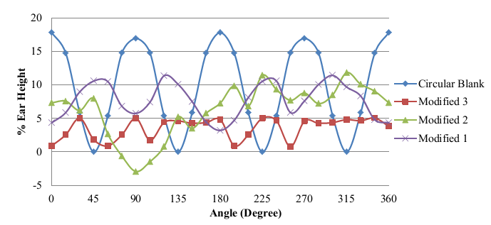
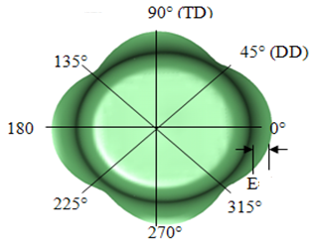
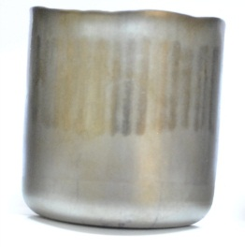
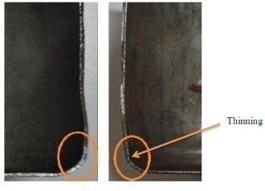
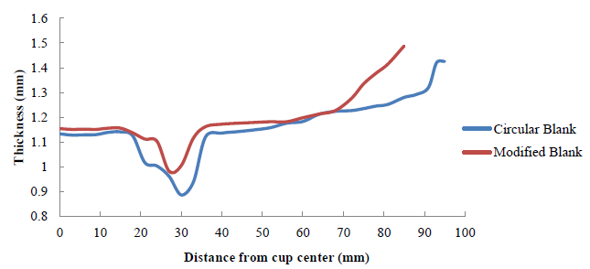
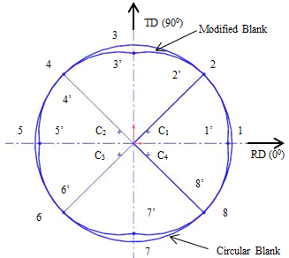
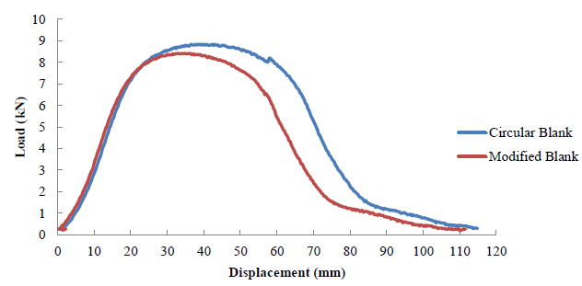
Improvement in Deep Drawing Behavior of Anisotropy Steel
Metal flow analysis
1.The ΔR₁ and ΔR₂ were
obtained as,
ΔR₁= R₀ - R₄₅
ΔR₂ = R₉₀ - R₄₅
2.Modified X-Coordinate
= R- β ΔR₁
Modified Y-Coordinate
= R- β ΔR₂
3. Modified blank 1 for β=6.
Modified blank 2 for β=5.
Modified blank 3 for β=4
Initial blank shape modification to minimize earring
Improvement in deep drawing behavior
7

Slide 18
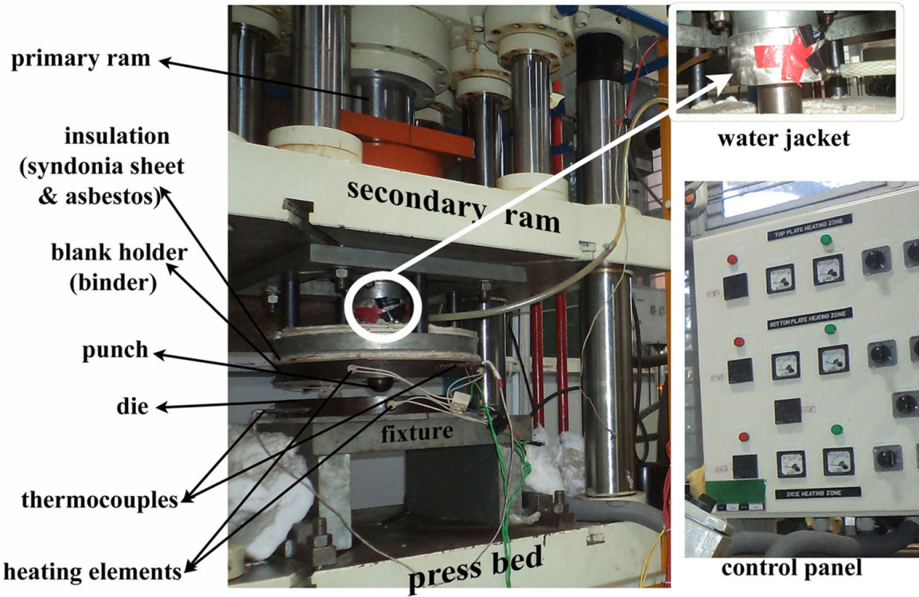
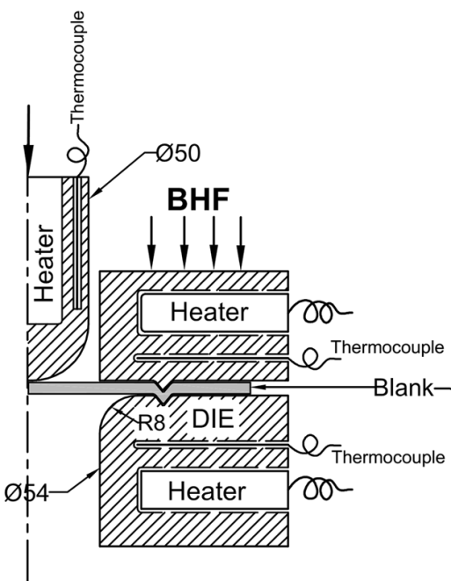
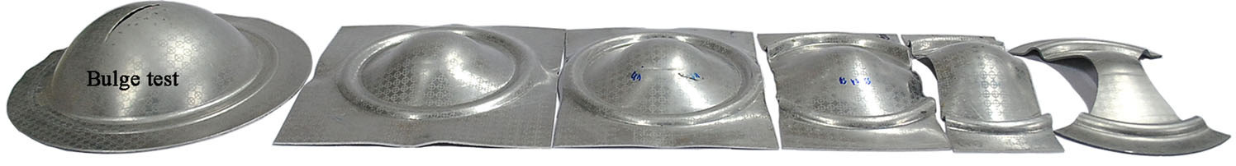
Laboratory scale formability testing facility developed at IIT KGP
The ability to distribute strain over an arbitrary tool surface is a complex interaction of mechanical properties, tool design and process parameters.
Design variables
Draw-bead size, Die corner radius, Punch corner radius, Punch-die clearance
Process variables
Mode of stretching, Strain path, Temperature, Deformation speed, Blank holding pressure, Lubrication.
100 ton double action press
Limiting dome height test rig
Stretch formed specimens in different strain path till failure
4

Slide 19
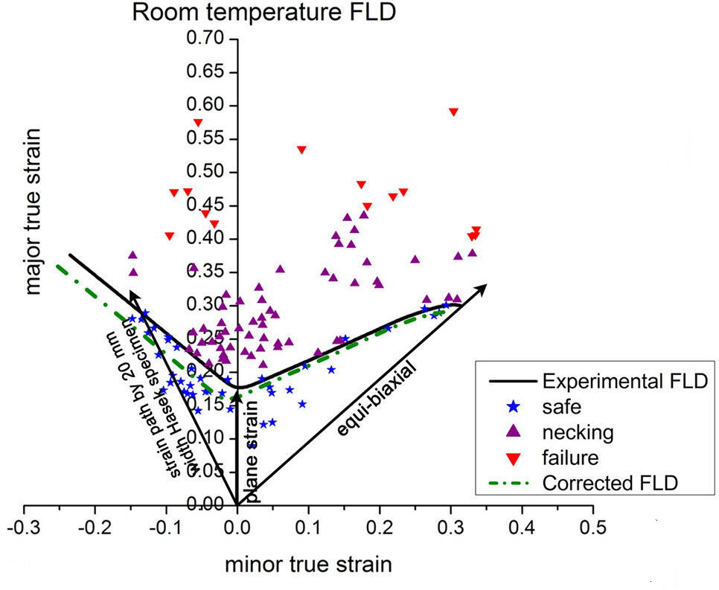
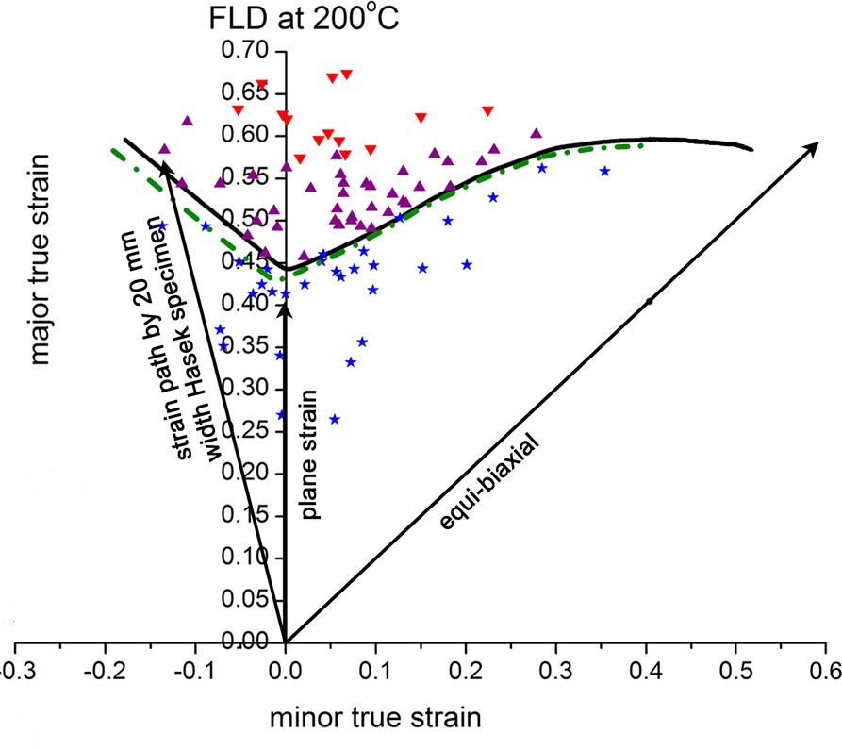
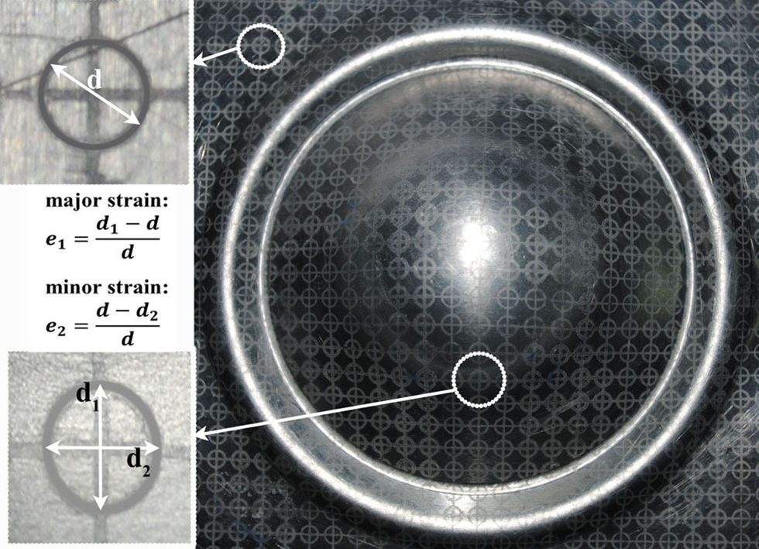
Forming Limit Diagram: Measure of formability
Tension-compression region
Tension-tension region
FLD₀
Limiting surface strain
FLD as failure diagnostic tool in sheet metal stamping industries
5

Slide 20
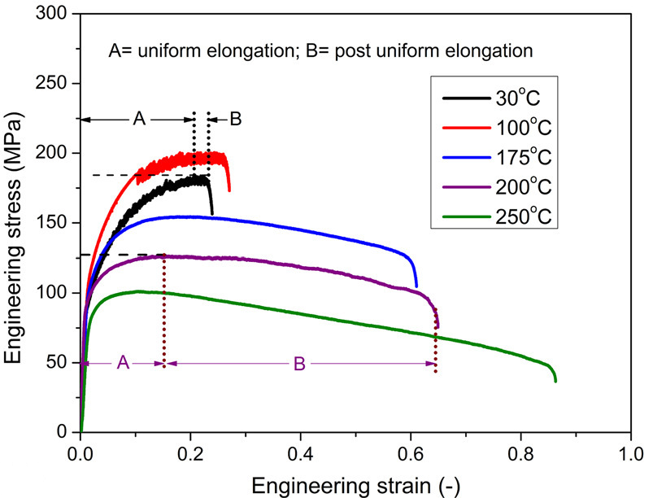
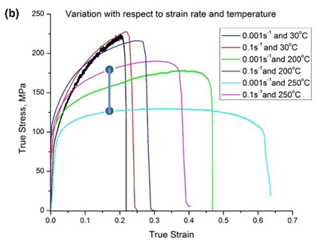
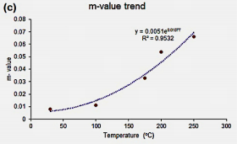
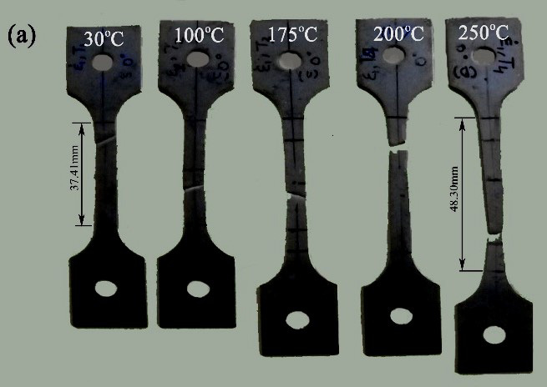
Tensile properties we are investigating
At constant strain
High m-value promotes large deformation
3

